Slide 1
ASP.NET Core

Slide 2
Razor Views
Notes:
Razor Views
In this chapter we will be focused on features of the Razor view engine.
Although we've already been using Razor to render HTML with our model data sprinkled inside, we can make some improvements to the application by using some features we have not looked at yet and some features that are brand new for this version of MVC.
The first feature we will look at is a feature to give us a more consistent structure across the application.
This feature is the Layout view feature.

Slide 3
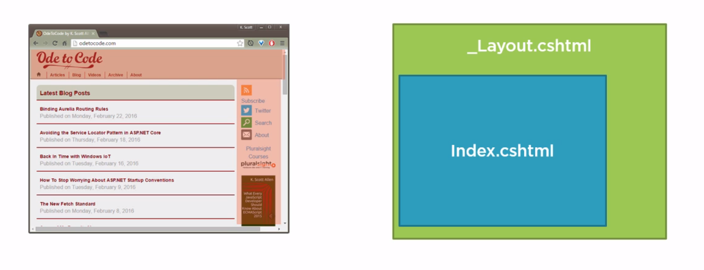
Layout Views
Top Area
Footer
Side Bar
Notes:
Layout Views
Most websites and web applications will want to create pages that present some common elements.
You typically have a top area on every page where you display a logo and a navigational menu.
Then you might also have a sidebar with additional links and information and probably a footer at the bottom of the page with some small print.
Every page of the application will want to have these common pieces, but we don't want to duplicate these pieces in every view that we write.
This is where Layout views are helpful.
A Layout view is a Razor view with a .cshtml extension, and you can name a Layout view whatever you like.
We'll be using a Layout view with a name of _Layout.cshtml. This is a common name for a Layout view, and the leading underscore isn't required.
That is just a convention that many developers follow to identify a view that is not a view that you render as a view result from a controller action. Instead, it's a special kind of view.
Once we have a Layout view, we can set up our controller views like the Index view for the home page.
We can set up this view to render inside of the Layout view at a specific location.
This Layout view approach means Index.cshtml doesn't need to know anything about the logo or the top level navigation.
The Index view only needs to render the specific content for the model the controller action gives this view and the Layout view takes care of everything else.
Let’s try it out.

Slide 4
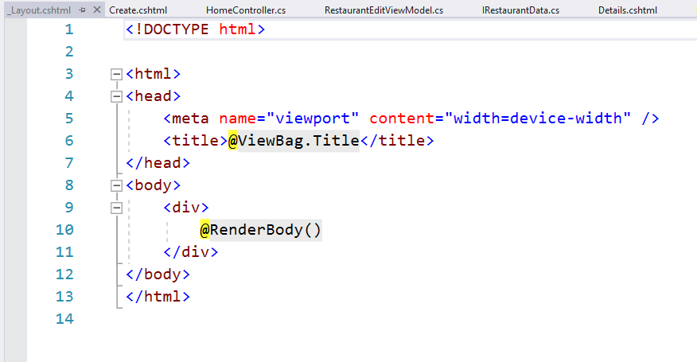
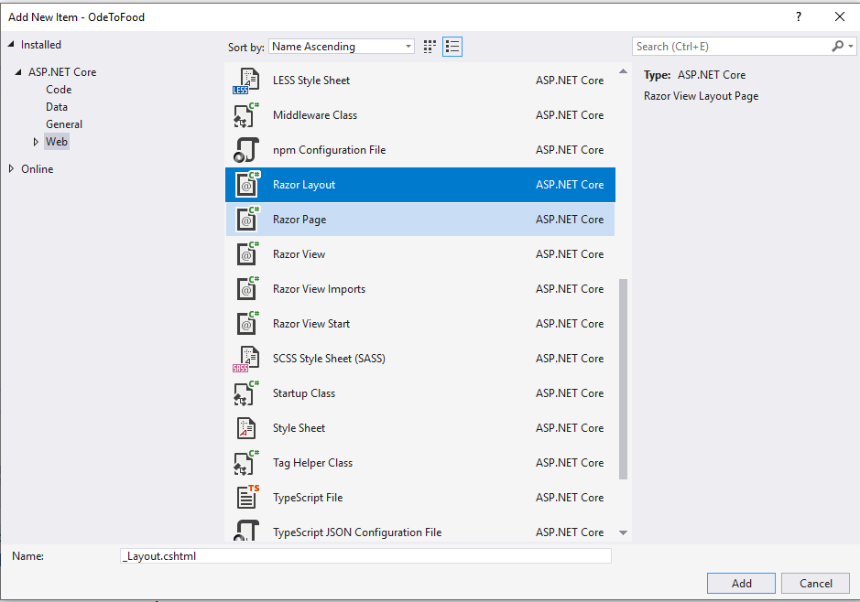
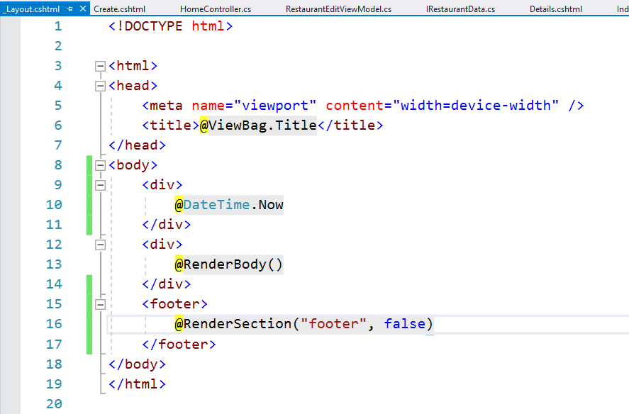
Layout Views
Notes:
Layout Views
Inside of the application, we have three views that are rendered by the HomeController, so they are in the Home folder.
They all contain some amount of duplicate markup. They all have an opening HTML tag and a head tag and a body tag.
Even though we don't have a navigational menu in this application, chances are in a real application we would want to have one. We don't want to duplicate that markup in every view. We would want to create a Layout view.
We will add the Layout view to a new folder named Shared. This is a conventional folder that the MVC framework knows about.
It knows that views inside of here might be used by multiple controllers across the application.
It's inside of there where we want to add an MVC View Layout Page. The default name is _Layout.cshtml, but you can name a Layout view whatever you want.
You can even have multiple different Layout views and choose the Layout view that you want to use at runtime depending on the user or the season. We'll see how to select the Layout view in just a bit.
We click Add, and this is what we will get by default for our new Layout view. We do want the Layout view to be responsible for managing the head and the body.
It is a Razor view, so we can still use C# expressions inside. We can still add literal text. We add DateTime.Now in a <div>.
You'll notice two other expressions inside of the Layout view:
The first one is RenderBody(). When an MVC controller action wants to render the Index view, and there's a layout page involved, the Index view, the HTML it produces, will be placed there where the method call to RenderBody exists. We can expect all of the content views throughout our application to appear inside of this div where RenderBody is called.
The other expression inside of this file is ViewBag.Title. ViewBag is a data structure that you can add any property and any data that you want to into the ViewBag. We could add a ViewBag.Title. We could add a ViewBag.CurrentDate. We could have any properties that we want on the ViewBag--we'll see how to set one in just a moment--because the expectation is that individual views like Index.cshtml and Details.cshtml, they will set a Title property on the ViewBag. This is because the Layout view is responsible for rendering this title tag. But since the Layout view is going to present multiple different content views, it doesn't know what the title should be. What the ViewBag allows us to do is pass along some information from our content view like Index.cshtml, pass that information along into the Layout view so our title element has the proper text inside of it.
There's one more expression that is quite commonly used inside of a Layout view. We create a footer element at the bottom of the page. That is RenderSection. RenderSection is useful when a content view like Index.cshtml might need to output markup into different places in the Layout view. By default everything that Index.cshtml produces will go where RenderBody appears. From Index.cshtml, we can also have named sections, and Index.cshtml has the ability to render HTML into the section called footer, and it's up to the Layout view to place that into the page at the correct location. With our call to RenderSection, if a specific view wants to render a footer section, it will go to the bottom of the page inside of a footer element. Notice the second parameter to RenderSection is a required flat. By default, this section is required, meaning every view we create will need to render a footer section. If we want this to be optional, we can pass in a false flag. If that view doesn't have a section, then we won't have anything inside of our footer element.
Save Layout.cshtml.

Slide 5
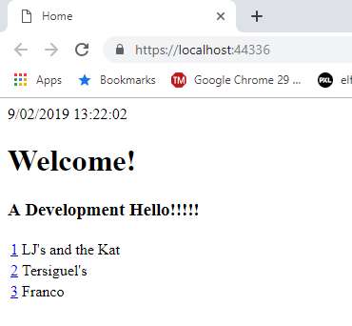
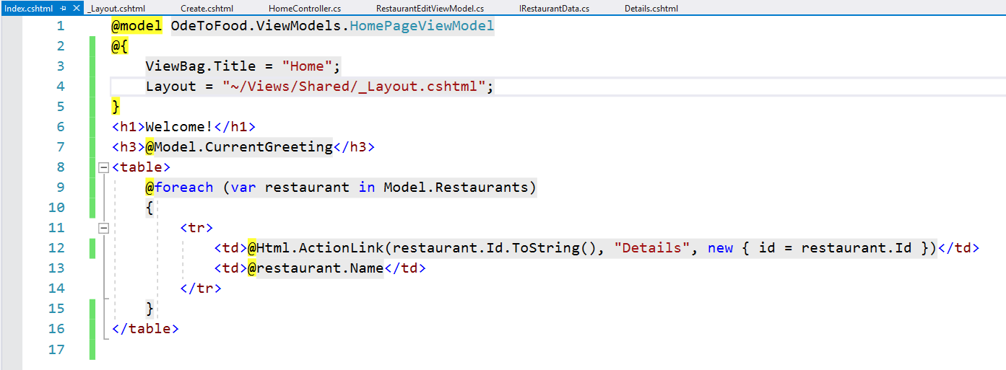
Layout Views
Notes:
Layout Views
Let’s see how we can get this working in our Index view.
The first thing we'll do is remove the markup that we no longer need inside of the Index view.
We can remove things like the HTML tag and the head tag.
We'll have to come back and remember to set the title later though.
We do that with a ViewBag.
We also don't need the opening body element or the closing tags.
We hit Ctrl+K, Ctrl+D in Visual Studio, that will apply some formatting and get rid of the indentations that we don't need.
Now we are down to the essence.
We are only rendering from Index.cshtml, that content that is specific to the home page.
We still need to do two things. We need to tell the MVC framework that we want to use that Layout view from this view, and we need to set the appropriate title by adding some information into the ViewBag.
We will do both of these things by creating a block of C# code. When we use the expression @restaurant.Name, the Razor view engine knows that we have this C# expression that should be evaluated, and the result of that expression should just be placed into the HTML.
But when we start using curly braces, we have a block of C# code. It's not going to output anything into our page, but it does give us the ability to execute code and change our environment and give the view engine some instructions.
For example, one thing we can do is tell the ViewBag that it should have a new Title property, and that title should be Home.
When we’re inside of a block of code like this, the normal C# rules apply. We have to start using semicolons in the appropriate location.
The other thing we can do is tell the MVC framework about the Layout view that we want to use.
Layout and ViewBag, those are both properties that we inherit when we’re inside of a Razor view.
We need to explicitly set the layout that we’re going to use.
Unlike other view conventions, we need to provide an explicit path to the Layout view.
So we’re going to use a tilde. That tells the framework to go to the root of the project, then go into the Views folder, then go to the Shared folder, and then use the file _Layout.cshtml.
Obviously, this is a place where you could apply some logic and perhaps dynamically determine which Layout view that you want to use.
Save everything and refresh our home page.
It's still going to appear mostly the same.
We did add one feature, which is to display the date.
But now using the Layout view, we don't have as much duplicated HTML throughout our application.

Slide 6
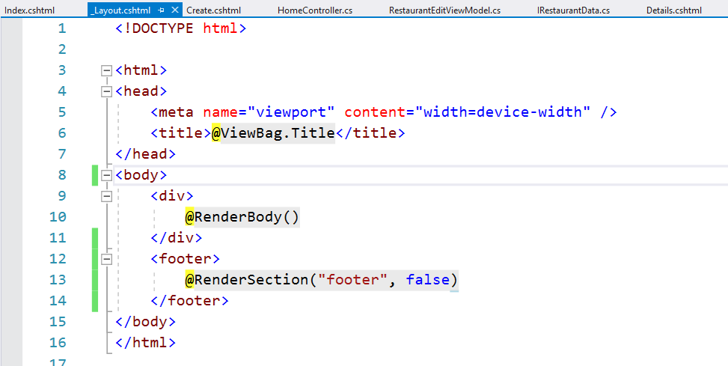
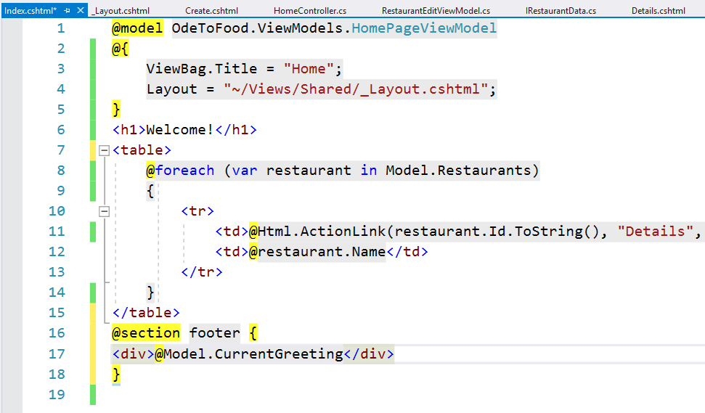
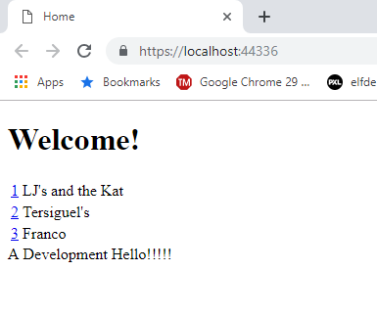
Layout Views
Notes:
Layout Views
We can easily manage an element that has to appear everywhere like a navigational menu.
Let's go back to the Layout view and remove this DateTime.Now.
That was just a test to make sure we were using the Layout view.
Let's also render a footer section from Index.cshtml.
Instead of displaying this current greeting at the very top, that's something that should appear at the bottom of the page inside of the footer.
The way to do this is to use an @section directive. We give this section a name, so we’re telling Razor that we want to render the greeting inside of the foot section.
It's almost like writing a block of code because everything inside of these curly braces will go into that section.
Instead of an h3, we use a normal div.
Save and run and let's see if the current greeting appears in the right location, and it does.
So now that we have a Layout view in place and we know it's working, the next goal would be to fix up the Details view and the Create view that we have to also use this Layout view.
Before we do that, let’s see how to avoid specifying the Layout view inside of every single content view.

Slide 7
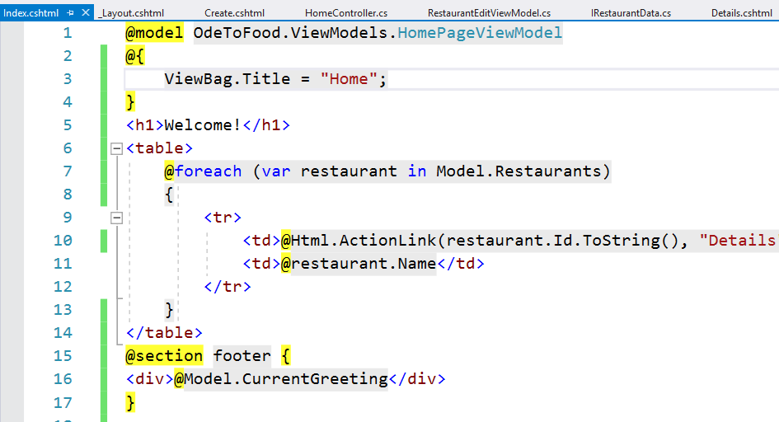
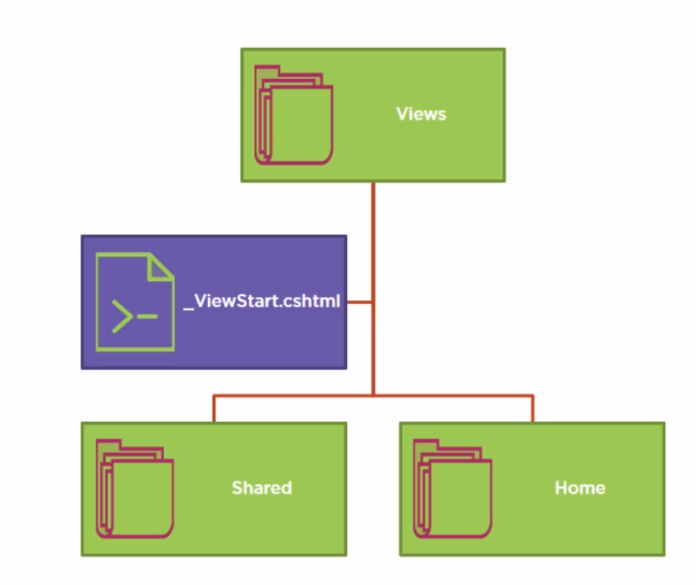
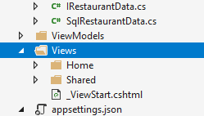
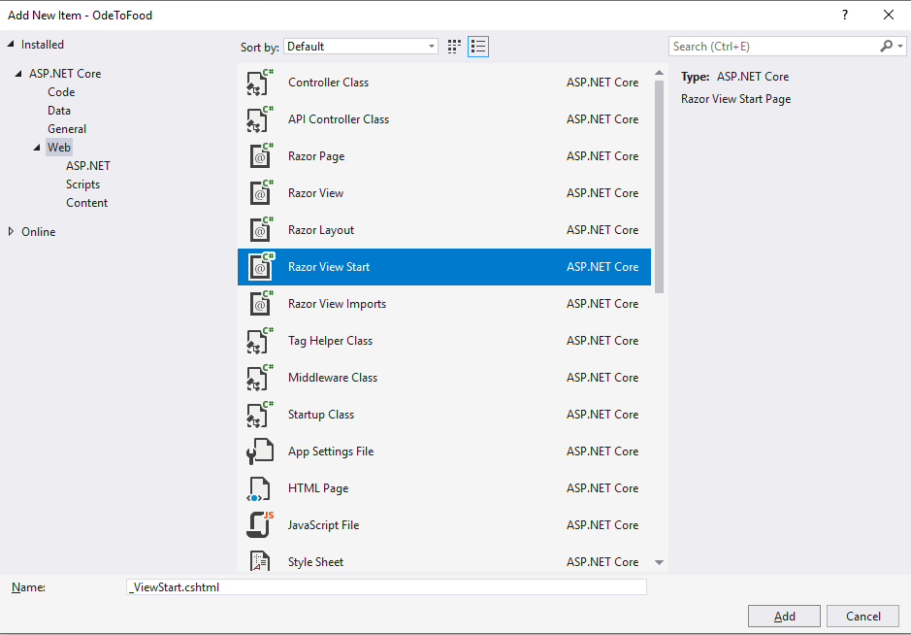
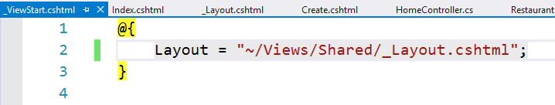
_ViewStart
Notes:
_ViewStart
The Razor view engine in MVC has a convention where it will look for any file with the name _ViewStart.cshtml and execute the code inside of this file before executing the code inside of an individual view.
The code inside of a ViewStart file cannot render into the HTML output of a page, but it can be used to remove duplicate code from the code blocks inside of the individual views.
In our example, if we want every view to use the Layout view that we just created, we could put the code to set the Layout view inside a ViewStart instead of having the code inside of every view.
In the application, we don't want every view to have to specify that its Layout view is _Layout.cshtml, so we’re going to cut the line of code (Layout = …) out of our Index view.
We’re going to execute that line of code from a ViewStart file instead.
If we right-click on the Views folder, and add a new item, there is a specific template in ASP. NET MVC for a ViewStart page.
The most important part is that this file is named _ViewStart.cshtml. The primary use for a ViewStart file is to set the Layout view.
We replace what is here with the line of code that used to be in our Index file.
How ViewStart really works:
When the MVC framework goes to render a view, it will see if there's a ViewStart file somewhere in the folder hierarchy.
Since we placed _ViewStart directly into our Views folder, this is going to impact all the views through all of the folders that are inside of here, both the views inside of the Home folder, as well as the Shared folder, as well as any other controller folders that we might add in the future.
If we were to, instead, take ViewStart and place it only in the Home folder, then this little bit of code would only execute when we’re rendering one of those views in the Home folder.
We can even have multiple ViewStart files, so we could have a _ViewStart.cshtml in the Views folder that sets the Layout view for all views.
If we wanted to change that default for all of the views just in the Home folder, we could have another ViewStart in the Home folder that sets the layout to something else.
We can also still override the Layout view if I wanted to from Index.cshtml.
If we added Layout = some other cshtml file, what we specify in the Index view would win because the ViewStart code runs before this code that's in our view.
We can also say Layout = null, which is a way to tell the framework that we don't want to use a layout page.
But we should be able to have that in our ViewStart file.
If we save everything, our home page still renders just the way it did before, and we still have the Layout view in effect. We just don't have to specify it everywhere.

Slide 8
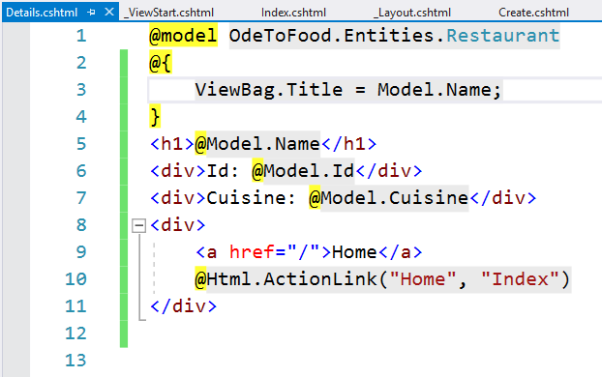
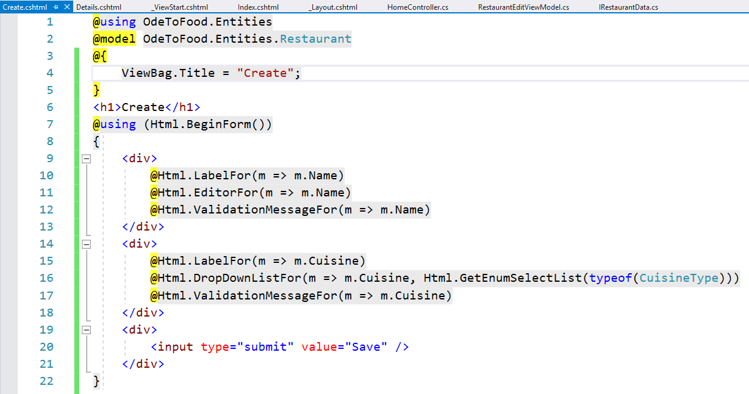
_ViewStart
Notes:
_ViewStart
We can come into the Details view.
We get rid of everything except for the content that we really need and Ctrl+K, Ctrl+D to do some formatting.
We still want to set ViewBag.Title, so ViewBag.Title = the name of the restaurant..
We do the same for the Create view.
Again, we can get rid of all the opening HTML. That's taken care of by the layout page. Ctrl+K, Ctrl+D to do some formatting.
We just need to set the title.
Now our entire application should be using this Layout view.
We should be able to see it from the home page, also when we go to a Details view, and also when we try to create a restaurant.
There's one more special view to talk about. It's a view that can help us remove using statements from individual views.

Slide 9
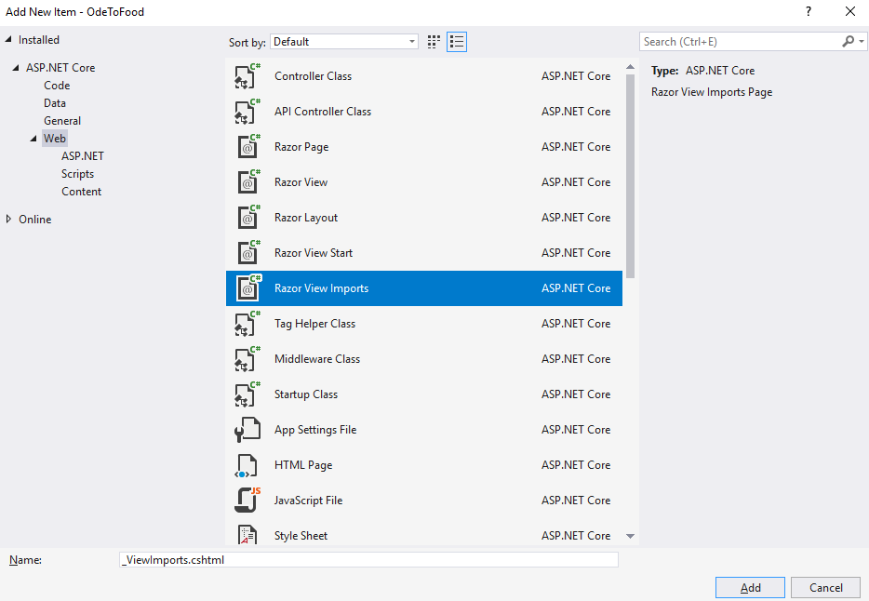
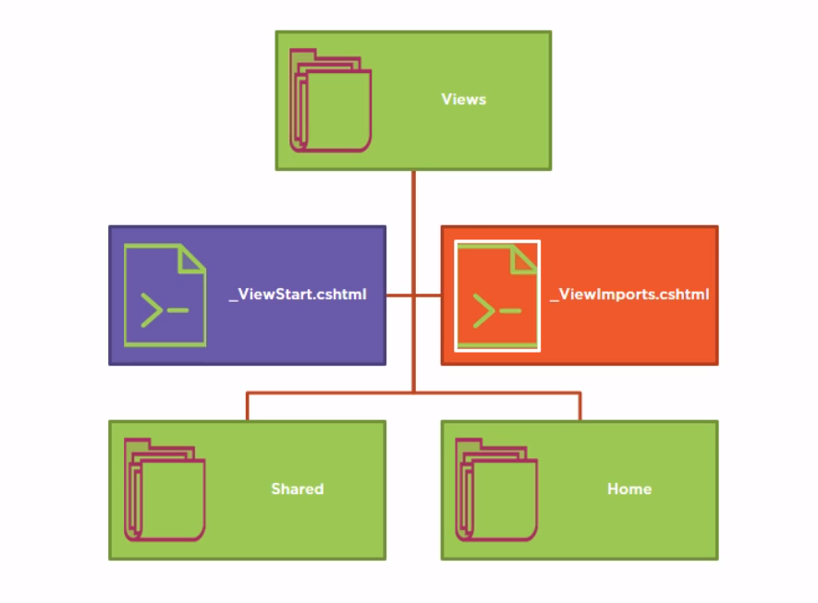

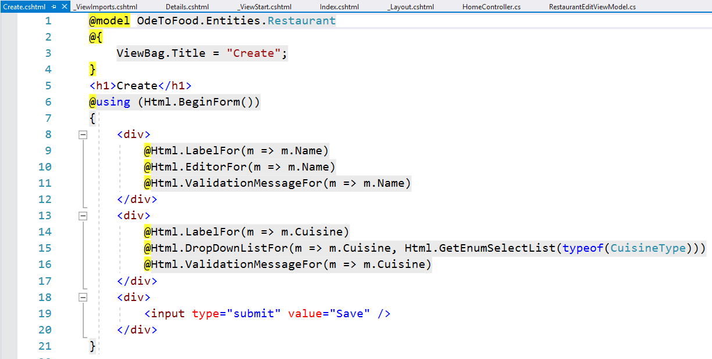
_ViewImports
Notes:
_ViewImports
In addition to the ViewStart file, there also a ViewImports file that the MVC framework will look for when rendering any view.
Like the ViewStart file, we can drop ViewImports.cshtml into a folder, and the ViewImports file can influence all the views in the folder hierarchy.
This view is new for this version of MVC.
In previous versions of MVC, we could use an XML configuration file to configure certain aspects of the Razor view engine.
Those XML files are gone. We use code instead.
The ViewImports file is a place where we can write code and place common using directives to pull in namespaces that our views need.
If there are namespaces that we commonly use in our views, we can have using directives appear once in our ViewImports file instead of having using directives in every view or typing out the full namespace of a class.
ViewImports also has another purpose, but we'll talk about that later. For now, let's see how to move our using directives into ViewImports.
Inside of the Create view, we have a using directive to bring in the namespace OdeToFood.Entities.
That will allow the code that is generated from this Razor view to compile correctly because without that using directive, the C# compiler won't be able to find this restaurant type.
We could prove that if we just swing over into the create action.
One of the errors that we'll see is: ‘the type or namespace 'Restaurant' could not be found’. It might be that several of our views need that same using directive.
Instead of placing that inside of each view, we create a new Item _ViewImports.cshtml in the Views folder so that it will add using statements to every view here a new item, which will be a ViewImports page.
It has to be named _ViewImports.cshtml. Just like ViewStart, we cannot use this file to render HTML, but if we paste our using statement into ViewImports, all of our views that appear in this folder or any subfolder will be able to use types from OdeToFood.Entities without specifying that exact using statement.
For our next topic, we're going to add something else into the ViewImports. We're going to add some tag helpers.

Slide 10
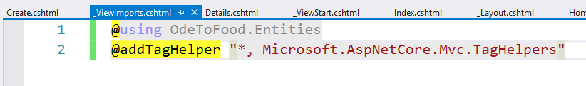
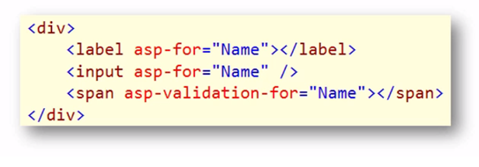

Tag Helpers
Html Helpers
Notes:
Tag Helpers
Tag helpers are a new feature in this version of MVC.
Tag helpers, just like HTML helpers, will help us render HTML. In many cases, you can replace an HTML helper with a tag helper.
Why would you use tag helpers instead of HTML helpers?
Well, tag helpers blend in to the HTML because they appear as if they are HTML attributes or HTML elements.
Like the asp-for attribute, this is a tag helper, and it blends into the HTML much better than in Html.EditorFor or Html.LabelFor.
We use those helpers when we added a Create view.
Whether you choose to use HTML helpers or tag helpers, it's really a matter of personal preference.
Many people are finding tag helpers to be easier on the eyes, and they make for views that are easier to author and maintain.
In order to use these tag helpers, we do need to install a NuGet library and also add an addTagHelper directive to the view or views that use these tag helpers.
Let's get an introduction.
The first step in using tag helpers in our project will be to add a dependency on tag helpers because we started this project from scratch.
We add the using statement of _ViewImports.html and now anybody can author a tag helper.
If you can think of a tag helper that you need, you can write your own tag helper.
You can place it right inside of your application project.
You do need to tell the Razor view engine about the tag helper because, by default, these tag helpers, even though they look like they blend into the HTML, they aren't just rendered down to the client.
Instead, Razor will call into some code to process a tag helper. It can remove itself from the HTML. It can add additional HTML.
There're all sorts of wonderful things that you can do with a tag helper.
But you do have to register your tag helpers with Razor, even the Microsoft tag helpers, in order for Razor to be able to spot these tag helpers in the markup and to be able to call into the code that processes the tag helper.
The directive to do that is addTagHelper, and you can place this into an individual view, or if you plan on using tag helpers throughout the application, you can use @addTagHelper inside of the ViewImports file.
In addition to adding effectively this using statement to all of your views, we’re also going to tell Razor to register the following tag helpers.
The syntax to register all of the tag helpers that are in an assembly is to use asterisk comma (*, ) and then the assembly name, Microsoft.AspNetCore. Mvc.TagHelpers.
Because this first piece is really a type name, this is where we could list a specific tag helper if I only wanted to use one.
But if we just wanted to take all the tag helpers that are in this assembly, we can just use the asterisk.

Slide 11
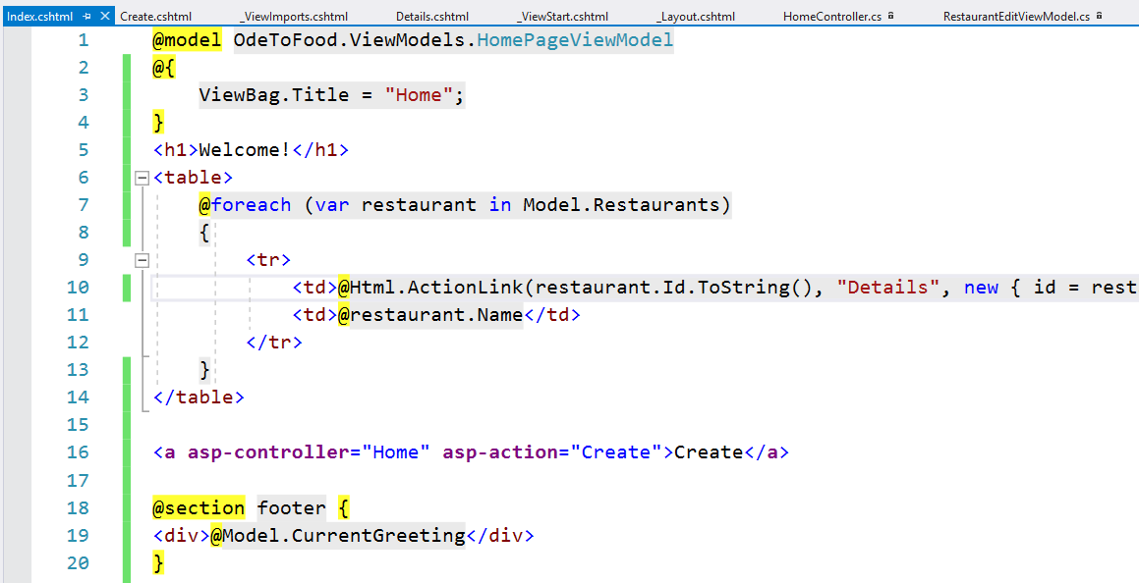
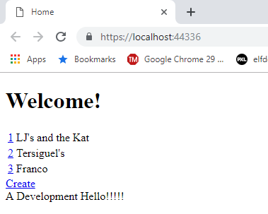
Tag Helpers
Notes:
Tag Helpers
There are many tag helpers available.
We encourage you to go out and look at the tag helper library and see which ones might be interesting to you. We’ll demonstrate a few of them.
In the Index view currently, we already have an HTML helper using ActionLink to generate an anchor tag that will point to a URL that allows us to get to the details of a restaurant.
There's actually another link, that we should really add to the home page, and that is we need a link that can send us over to that form where we can create a restaurant.
From here, the only way we can create a restaurant is to type into the address bar. If we wanted to use a link, we could use Html.ActionLink.
Sometimes that feels a little bit cumbersome.
We us an anchor tag that displays the text Create. But we want to set effectively the href attribute. We want it to point to /home/create, and we could just use HTML, but we can also use some tag helpers that just like HTML ActionLink will use some information that we provide to figure out what the URL should be if we want to reach some controller and some action on that controller.
These tag helpers are asp-controller, we can say we want to go to the HomeController, and asp-action says which action that we want to reach on that controller.
Just like the HTML helper, if we just want to go to the Create action on the same controller that rendered this view, we can leave off the asp-controller part.
We will leave both of them there just to show you that some of these tag helpers, they work together.
Asp-controller and asp-action will combine their information together to figure out what the href should be and if we save this view and come back, we should now have a working link to create a restaurant.

Slide 12
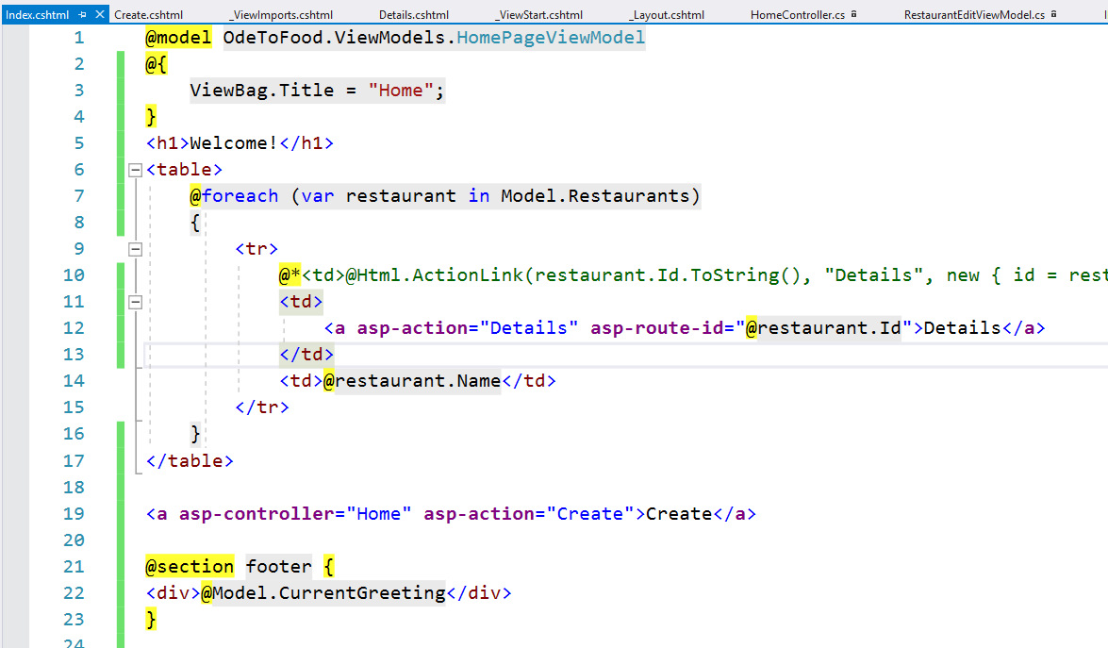
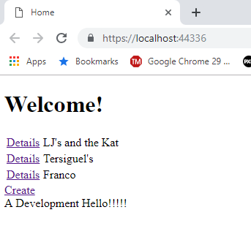
Tag Helpers
Notes:
Tag Helpers
And now that we have that, we’re going to remove asp-controller just because it's not required here.
What about the ActionLink that we’re using to go to the Details view.
This one is interesting because we need to pass along a restaurant Id.
Well in this case, we’ll have an anchor tag Details, and add asp-action="Details“. That's the name of the action that we want to get to.
Then any parameters that you want passed along, you can use the asp-route tag helper.
What's interesting about this tag helper is that you add the identifier for the data after asp-route.
In other words, if you want to include a parameter in the URL that is named Id, then we can use asp-route-Id.
If, instead, we wanted to pass something called title, we could use asp-route-title.
And we could have both of those, -Id and -title, if we needed two pieces of information to build the complete URL.
But in this case, we only need one, and this has to be the restaurant.Id.
Remove the HTML helper and save your file. Let's just make sure that works by coming back to the home page, doing a hard refresh.
You know this worked because previously we were displaying the Id as the linking text. Now we’re showing the text Details. But we’re still building the correct URL now using tag helpers instead of HTML helpers.
In addition to the tag helpers, there're also tag helpers for building forms.
We’re going to show you those. But there're also some very useful tag helpers, tag helpers like cache.
The cache tag helper is actually a custom element.
Remember, these tag helpers, they're processed on the server side, so it's not like we’re sending a cached element down to the client.
Instead, the tag helper code will jump in and rewrite some of the HTML for us.
With the caching tag helper, we can cache the content that is inside of these elements, these tag helpers, and they're programmable with attributes.
We can set different expiration policies using some attributes to expire at a specific point in time or to vary by some specific header.
We encourage you to look at some of the other existing tag helpers. We're going to take a look at some of the form-related helpers.

Slide 13
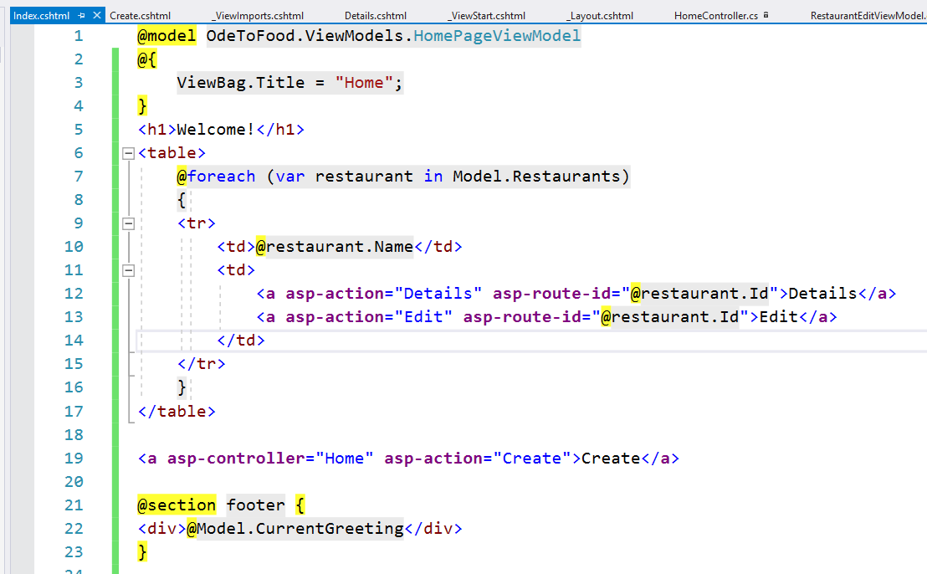
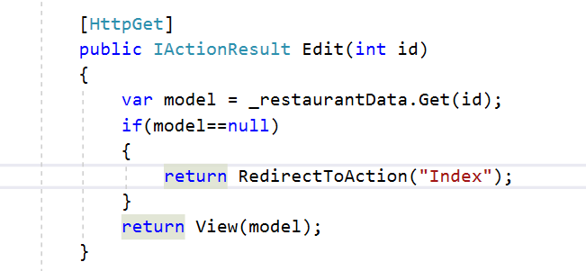
An Edit Form
Notes:
An Edit Form
To see how the form tag helpers are used, we build an entirely new feature for our application and give the app the ability to edit an existing restaurant.
We will start by adding a link on the side of each restaurant that will go to an Edit action on the HomeController.
We don't have that action yet, but we'll need to pass along the Id of the restaurant that we wish to edit, and we want to display the text Edit.
To make the UI a little less ugly, we’re going to cut that table cell so it's not the first table cell, and have these links appear after the restaurant name.
Later in this chapter, we will even get rid of the table.
For now, we’re going to save the view and come over to our controller where we will follow a very similar pattern to what we did with Create.
We're going to need an Edit action that returns the view that gives the user a form to edit a restaurant.
We'll need a second Edit action that will respond to an HttpPost.
First of all, we need the one that will respond to a GET request.
It's going to need to take a restaurant Id. Inside of the Edit action, we'll have very similar code to the code that we have in the Details action.
So we’re going to copy that code because, just like that code, we will first need to go out and get the restaurant that the user wants to edit.
We'll have to make sure that that restaurant actually exists. If it doesn't, we will redirect the user back to the Index view.
We change the return type to IActionResult. When we do have the restaurant, we will render the Edit view. We don't have that view yet, but we take a copy of the Create view.

Slide 14
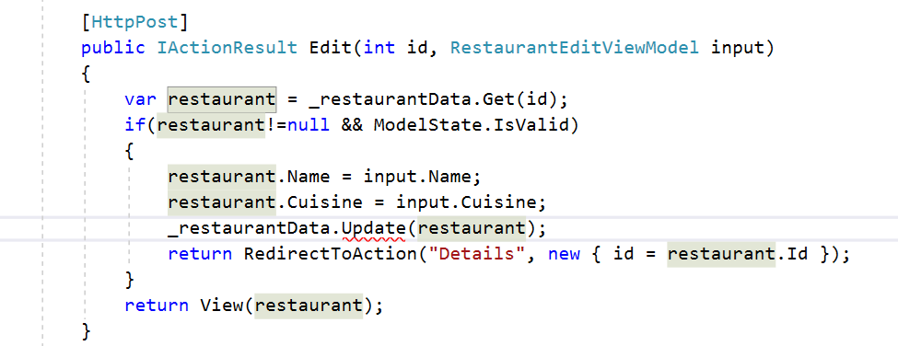
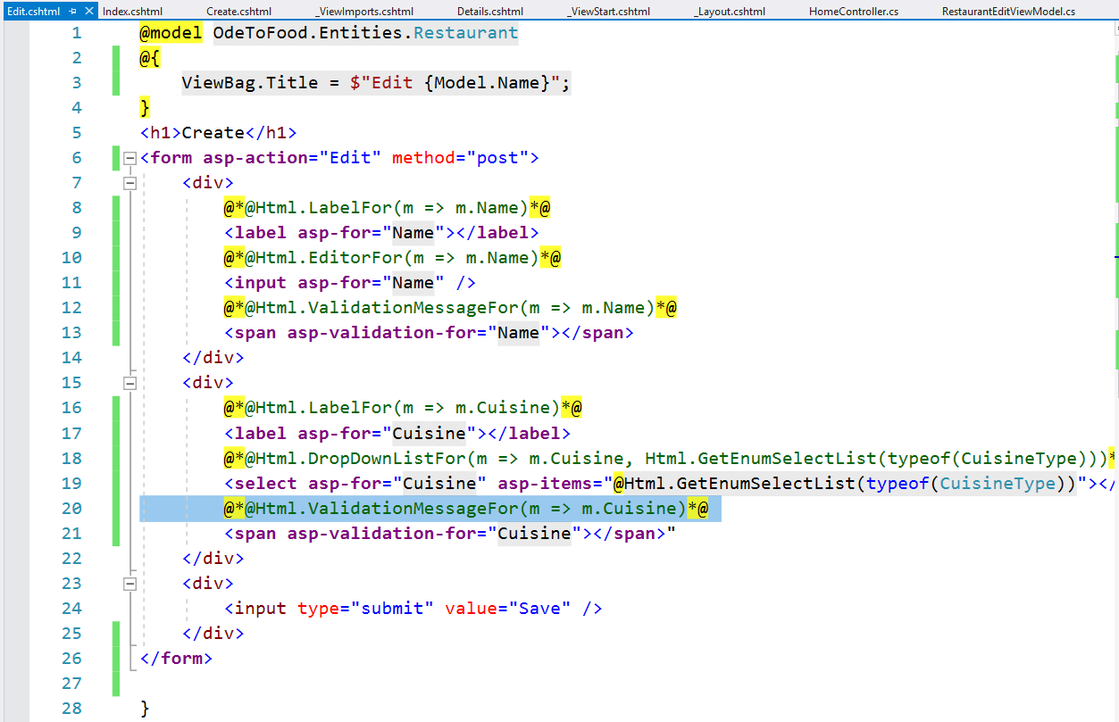
An Edit Form
Notes:
An Edit Form
We’re going to make a copy of that, Ctrl+C, and place it into this folder with Ctrl+V, and then just rename it to Edit.cshtml.
We’re going to close the preview window just because sometimes Visual Studio gets confused during a rename.
For the title of this page, we can say that we want to edit and then provide the restaurant name.
Let's actually use a C# 6 feature, string interpolation, and add $"Edit (Model. Name)".
This dollar sign in front will allow the runtime to replace Model.Name with a value that is in that property, so the name of our restaurant.
Now that we plan on using tag helpers, we’re going to get rid of things like Html.BeginForm and, instead, just use a regular form tags
Open form and close form.
On the side of the form tag, we can still use tag helpers like asp-action and asp-controller so that when the user submits this form, we go to a specific controller action.
In this case, we want to go to the Edit action on the same controller that we came from.
We do want explicitly that the method on this form, it should be using an HttpPost.
The default method for a form is a GET, and we do not want to edit a restaurant using a GET operation. That's a little bit dangerous.
Instead of using an HTML helper to build a label, we just going to use our regular Htm Label and then use a tag helper, asp-for, to say that this is a label for the Name property of the model.
Behind the scenes what this tag helper can do is set up the Html.
For attribute to have the correct value and to set the inner text of this label so that it actually displays what we want, like restaurant name or Name, just like Html.LabelFor would do.
What is one advantage to LabelFor, that this is a strongly typed expression.
If we were to ever rename a property, our refactoring tools could often change the expression that is inside of LabelFor, whereas with a tag helper, we really just have a string here.
There are some advantages to the HTML helpers.
There are some advantages to the tag helpers.
You'll just have to make the decision which one you like.
Do you prefer the clarity of the HTML, or do you prefer the strong typing and IntelliSense?
Now we need an input.
Once again, we don't have to declare the input type or the input name or the input value.
All of that will be taken care of for us if we just have an asp-for tag helper and add this is for the Name.
Same thing for the validation message.
This time we will create the span and use the validation-for tag helper to add that this should be validation messages for the Name property.
Let's do similar things for the cuisine. We need a label that will be for cuisine.
And, again, we don't have to set the text of that label. The tag helper will do that for us.
The drop-down list is a little bit intresting.
What drop-down list actually renders is a select element.
We can still say asp-for="Cuisine" so that the select has a proper name.
How do we generate our list of items?
We can still use this HTML helper to generate the list of items that we need.
Let’s copy, it and we will combine that HTML helper with a tag helper, asp-items, and we’ll paste our HTML helper in here.
We will need an at(@) sign because this is a C# expression.
But this just goes to show that there is not a tag helper equivalent for every HTML helper.
But in this case, there is an items helper that will allow us to specify the options for the select.
We just need the validation span, so a span that provides validation for cuisine.
This should give us everything we need to render the correct form and allow a user to edit a restaurant.
Let’s save the form, and let's come back to the HomeController.
Now we will respond to the HttpPost that that form will send.
Using the route constraint, HttpPost, give me a method IActionResult Edit.
Once again, we will take a RestaurantEditViewModel, not a restaurant itself, because we only want to capture items that are in that form.
There're actually a few different techniques that people commonly use to implement an edit action.
We could new up a restaurant and copy over the view model inputs into the real restaurant.
Or we could pull the restaurant again out of our restaurant data, and we'll do that by passing in an Id.
That means we’ll need an input parameter, Id. Where does this come from?
The edit form should always be delivered from an URL that has an Id in the URL according to our routing rules, so something like /home/edit/3.
The form is always going to post back to that same URL, /home/edit/3.
The MVC framework will be able to pull that Id out of the URL and pass it into as a parameter.
Some people also like to add explicitly hidden inputs to their form and rely on that hidden input to deliver the Id just in case the user is fiddling with the URL for some reason.
That's one decision you can make. We’re just going to rely on the Id coming in from the URL.
Remember we always want to check if ModelState is valid.
So, really, we want to check to make sure that this restaurant is in the database, so it's not null, and we want to make sure that our ModelState is valid before we try to do any update operations in the database.
If none of that is true, we’re going to return a view with that restaurant and allow the user to try again, although in a real application with concurrent users if the restaurant is null, maybe someone else deleted that restaurant.
If that's the case, maybe we want to separate these two checks, and if the restaurant doesn't exist, tell the user that the restaurant doesn't exist.
Otherwise, go on and then check ModelState.
And if ModelState is invalid then return a view and allow them to fix their edit so everything is valid.
We're going to forge ahead here.
ModelState is valid. So let us copy into this restaurant that we pulled out of the database, copy in the name from the Input restaurant and also the new cuisine because the user might have changed either one of those.
We will need to do something with restaurant data.
We'll come back to that in just a second.
But assuming all of this works, then we can redirect to the Details action just like we do in the Create scenario.
So a new anonymous object specifying that the Id to include in this redirect action is the restaurant Id.

Slide 15
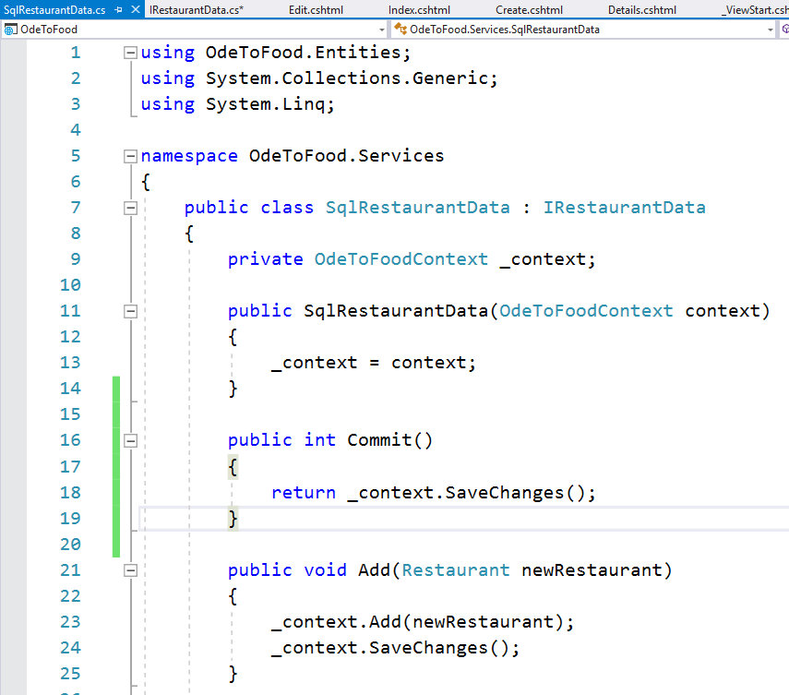
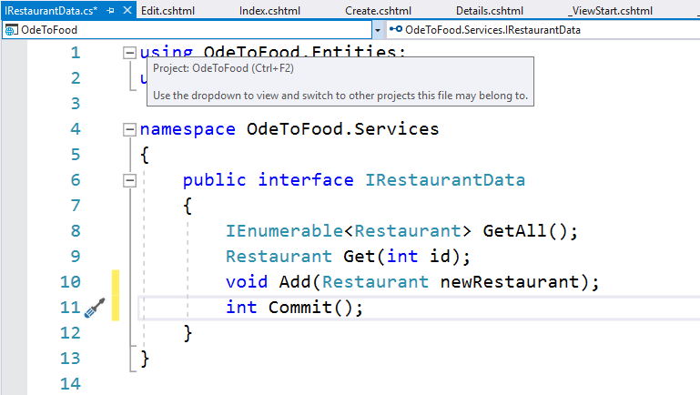
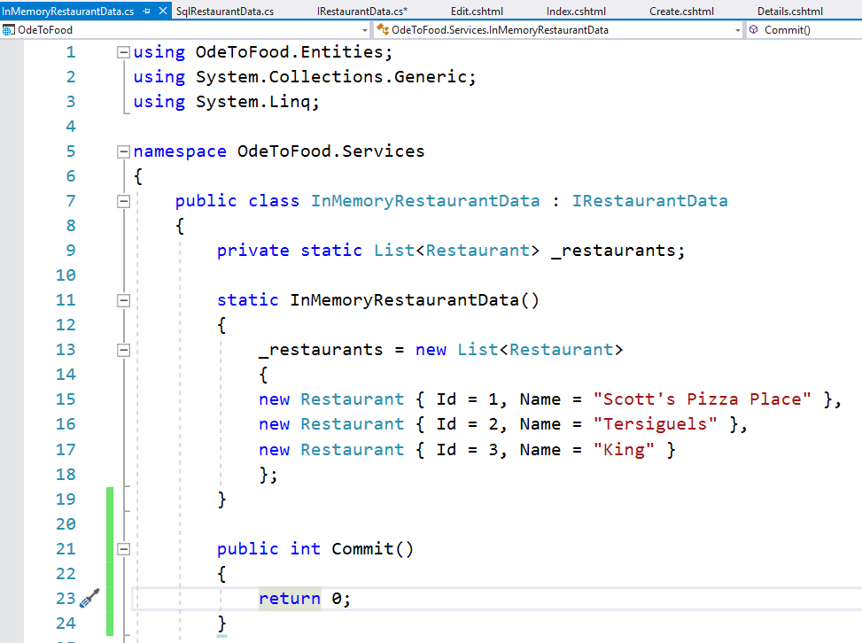
An Edit Form
Notes:
An Edit Form
Now the only question is, How do we want our data access layer to behave?
Do we want to use _restaurantData.Update and pass in our restaurant?
That would be the approach of what we could call a traditional data access layer where anytime you call a method to add or edit or delete something, the changes are immediately persisted into the database.
That's what we've done so far with our restaurant data. If we open up this service, you might remember earlier in this course, we had a discussion about the Add method.
Do we want to call into the Entity Framework and immediately save changes?
Or do we just want to add the restaurant and allow the application to add other things and modify other pieces of data and then explicitly call SaveChanges or some commit operation?
Because the Entity Framework itself, it doesn't actually flush anything to the database until we call SaveChanges, and with the Entity Framework, we have the ability to pull a restaurant out of the database, modify some of the properties, and then just ultimately tell our DBContext object to save changes.
It knows what restaurants have been pulled out of the database, and it knows which properties have been changed.
We don't need to tell it to explicitly update or save a restaurant. When we call SaveChanges, it's going to flush all those changes to the database.
We'd like to show you this approach, an approach where RestaurantData implements a unit of work design pattern.
You can find out more about that pattern in the Patterns course at Pluralsight.
But it's very easy to implement that pattern because a DBContext object implements that pattern.
In other words, instead of saving changes here, what we’re going to do is come out to RestaurantData and explicitly add a Commit operation.
This is a way of committing our changes to the database. It's going to return an int because when you call SaveChanges on a DBContext, it can return the number of records affected. We'll just go ahead and pass that back.
How do we implement Commit on our SqlRestaurantData?
Well that is as easy as just returning the result of _context.SaveChanges.
We really don't need an explicit method to update a restaurant.
Instead, we can just get a restaurant using the Get method, execute some code that will apply changes to that restaurant, and then commit.
The DBContext has tracked that restaurant. It will issue an update statement for us.
Since we’re keeping the InMemoryRestaurantData around (you can use this if you don't want to use the Entity Framework), let's also add a Commit operation here.
But we’re just going to return 0.
Essentially, if someone has retrieved a restaurant from this list, when they execute code that changes a property on that restaurant, those changes will already be reflected application-wide; there really is no commit for our simple InMemoryRestaurantData.
So, again, it's only useful for development work when there's a single person running the application.

Slide 16
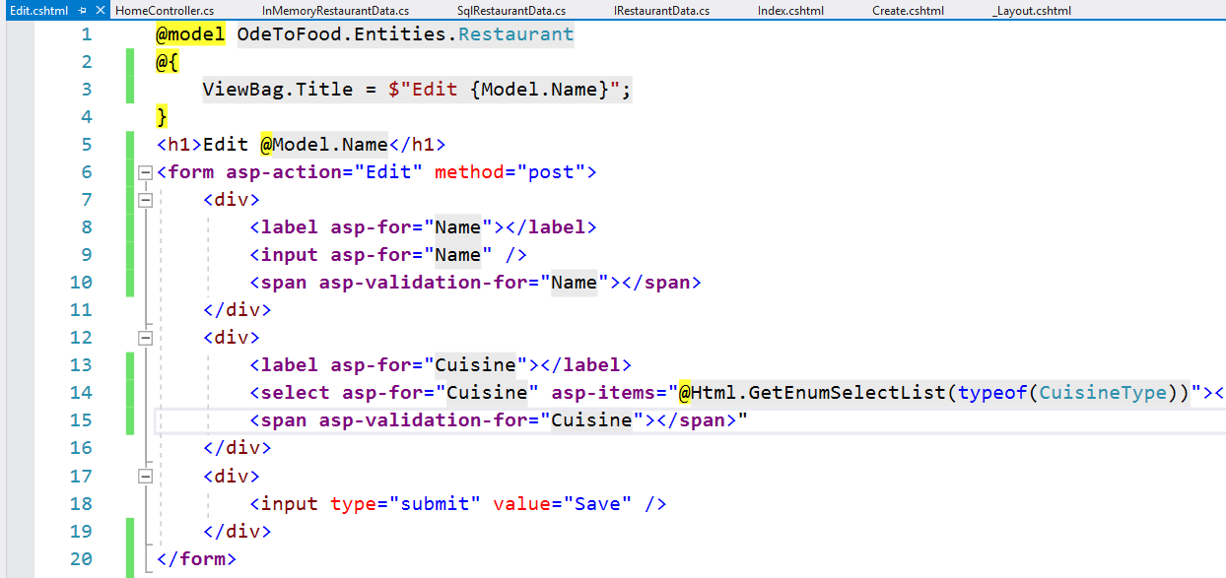
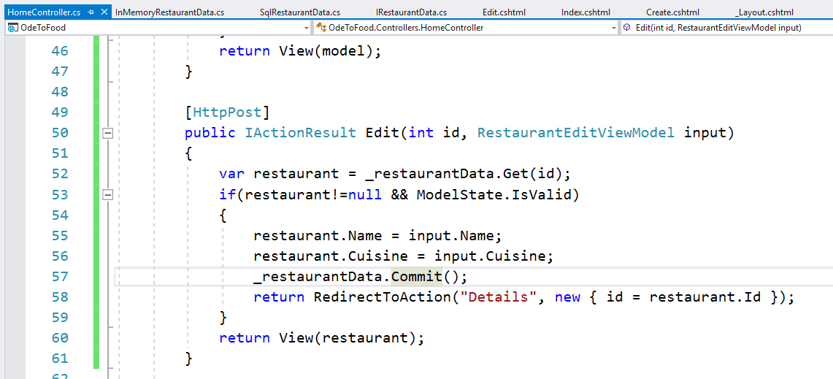
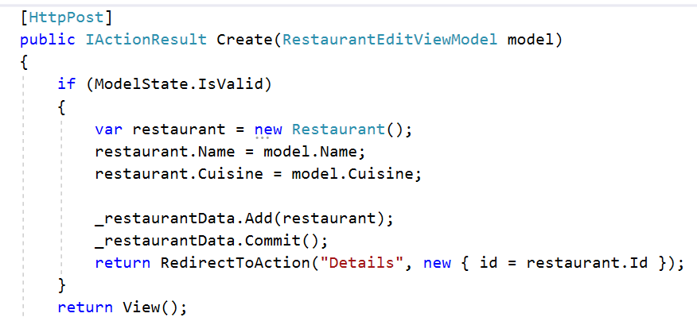
An Edit Form
Notes:
An Edit Form
Now that we have this in place, let's come back to the HomeController.
And with this type of data access object, all we need to do at this point is tell RestaurantData to commit all the changes that have been made to any entities.
Let's save everything, come back to the application.
We have an Edit link available. Let's edit LJ's and the Kat. What we'll do is just add an extra t and change the cuisine to American. we can see those changes were applied here.
There's the extra t. The cuisine is American. Let's fix the extra t, take that off, save again, and we’re pretty confident that the Edit view that we built with a tag helper is working.
We're actually saving these changes into the database. We did see one change that we want to make, and we can think of one other small change that needs to be made.
On the Edit view, we're still displaying the text Create. Let's instead mirror the title of the page to say we are editing a restaurant with this name.
The other change we want to make is in the HomeController. Now that we've changed around RestaurantData a bit, and we no longer immediately save changes when we add a new restaurant, then we do have to come into the Create action and add _restaurantData.Commit so that the restaurant data that we’ve added to the data source will be saved to the database.

Slide 17
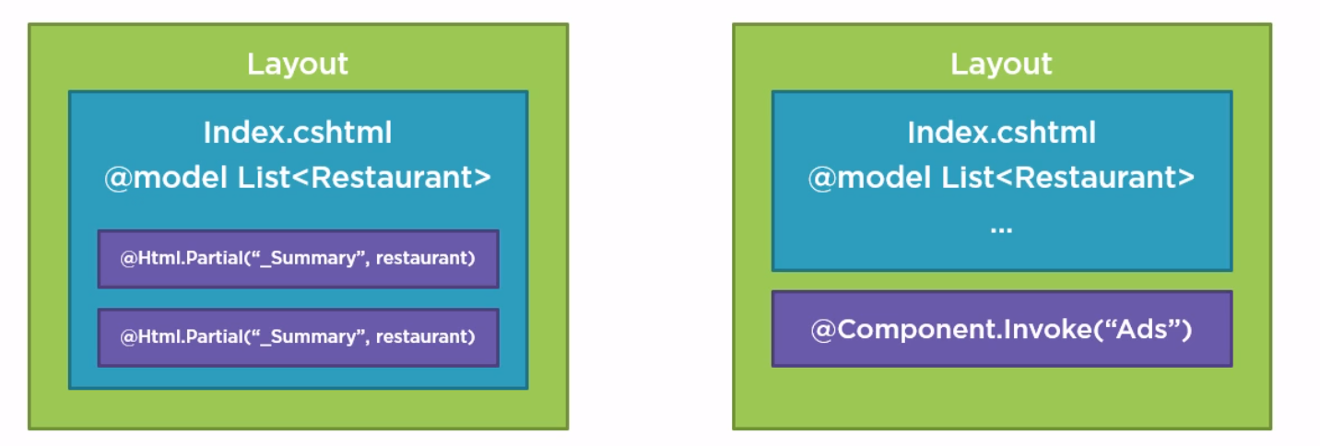
Partial Views
Notes:
Partial Views
The MVC framework has the concept of partial views. As the name implies, a partial view, which is just another Razor file with a .cshtml extension, a partial view is a view that renders just a part of the full view.
There are two use cases for partial views:
One use of partial views is when you have some view code that you want to re-use in the application. For example, you have a Layout view, and the Layout view is selected by an Index view that renders in the body of that Layout view. The Index view receives from the controller a model object that is a list of restaurants. The Index view has to display summary information about each restaurant. This restaurant summary might require a block of Razor code that also appears in other views that are displaying restaurant information. If that's the case, we can take the common code and put it in its own view, let's call it _Summary, and render that partial view from the Index view using an HTML helper named Partial. With Partial, we pass the name of a view and optionally a model object for that partial view to work with.
You can also use partial views to take a complex model object and break down the rendering of that object into smaller views. The key point here is that when using Html.Partial to render a partial view, the partial view relies on model data from the parent view.
The partial view cannot go out and get a model independently.
If you do need a different model for a partial view, this is where view components come into play.
View components are new in this version of MVC.
Imagine we have a layout page that is again selected by the Index view, and the Index view has a model which is a list of restaurants.
But a Layout view also needs to display some advertisements about restaurants using information from the database.
We don't want the Index view to provide that ad data since the Index view is only concerned with the restaurants themselves.
This is where we can build a view component and use Component.Invoke to render a component anywhere on the page.
We can use Component.Invoke from an Index view or a Layout view or any other partial view.
The wonderful part about view components is that they are separate objects, which can be instantiated and perform their own data access, build their own model objects, and render their own partial views.
Unlike Html.Partial, a view component doesn't rely on the parent view for anything.

Slide 18
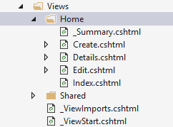
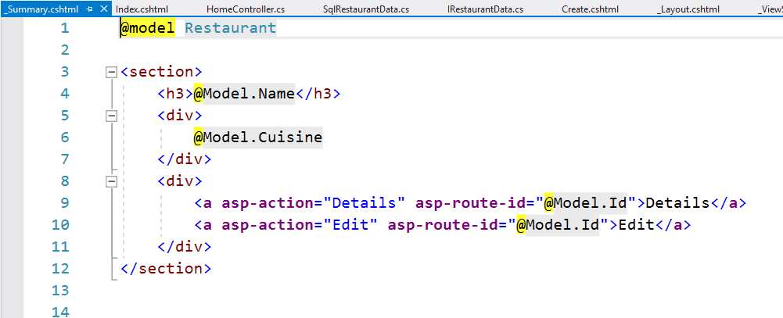
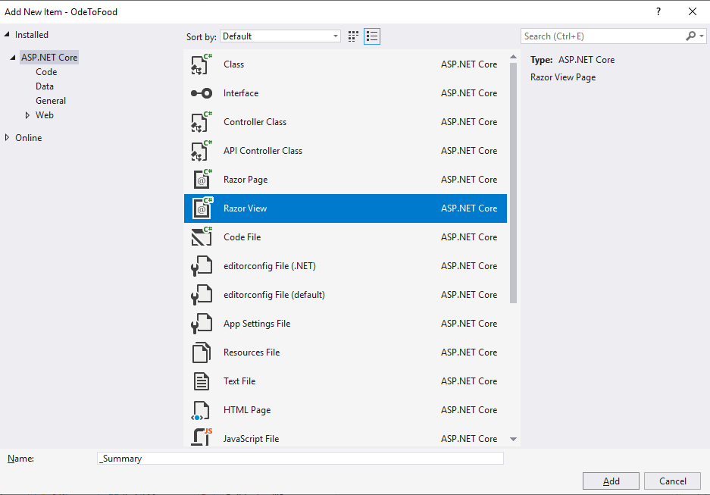
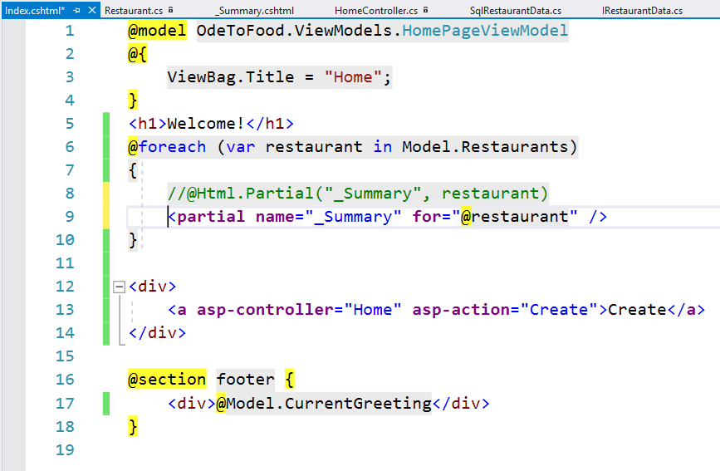
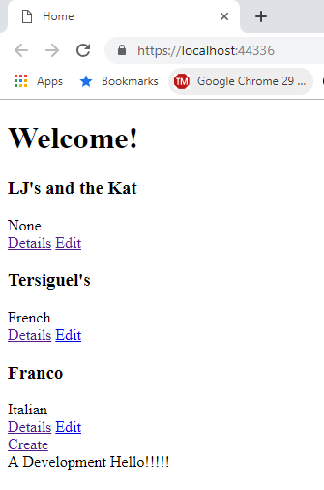
Partial Views
Notes:
Partial Views
Let's look at using Html.Partial and then create a view component in the next part.
Back in the application, we’re no longer using a table to display all of our restaurants. Instead, we want all of the restaurants to appear as cards.
We’re going to render all the restaurant information inside of a div or inside of a section.
Later, some CSS wizard will be able to come along and make these individual restaurant displays look really attractive.
This scenario doesn't force us to use a partial view, but it will demonstrate how to use a partial view.
You'll see it cleans up the Index view quite a bit.
Inside of the Index view, the goal is to get rid of the table.
We'll still have a foreach statement, but now for each restaurant that we have in our collection, we want to use Html.Partial to render a partial view.
Let's just call it _Summary. Each time we render that Summary view, it will need the information about the restaurant that it has to display, and we can pass that as the second parameter to Html.Partial.
Let's create that view. we can create this partial view in the Shared folder.
That means any view in the application can render this partial view.
Or we can just place it inside of the Home folder where the rest of our restaurant-related features are.
Now anybody that needs to display summary information about a restaurant can use this partial view, even the Details view could use this Summary view if it provided enough detail.
We right-click on the Home folder. We’re going to add a new item. we want to create an MVC View Page, and this will be called _Summary.
After we add this file, we’re just going to remove all the code that's in there.
We know our model will be a single restaurant. In order to style this appropriately, we will render the restaurant inside of a section.
Let's start off with an h3 element that will display the restaurant name and then a div that will display the restaurant's cuisine.
We still want our links that allow us to edit and detail a restaurant, so coming back to the Index view, we’re just going to copy the two links from the index view and paste them into our Summary partial view.
We will need to change restaurant.Id to Model.Id because that is our model object now.
We don't have a restaurant variable declared.
Now we have a nice simple reusable view that displays summary information about a restaurant and provides links to get to the details and edit that restaurant.
Let’s fix up the Index view.
We no longer need the table, and we place the Create link inside of a div. That might be important for spacing later.
You can see the Index view becomes very simple.
We receive a somewhat complex model object, but we’re just going to delegate the rendering of each individual restaurant to a partial view, and we’ll have a lot less code there.
When we run we still don't have the prettiest UI in the world, but we can apply some CSS to make this look much better.
So now that we've seen how to use Html.Partial where we can pass in model information for that partial view to use, let's take a look at how to build a view component.

Slide 19
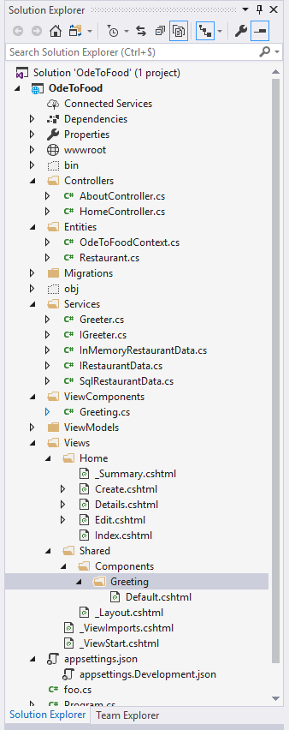
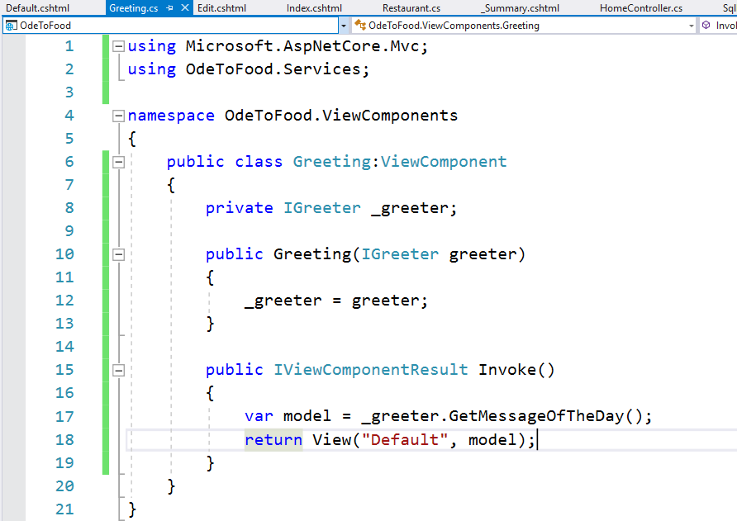
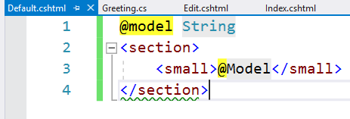
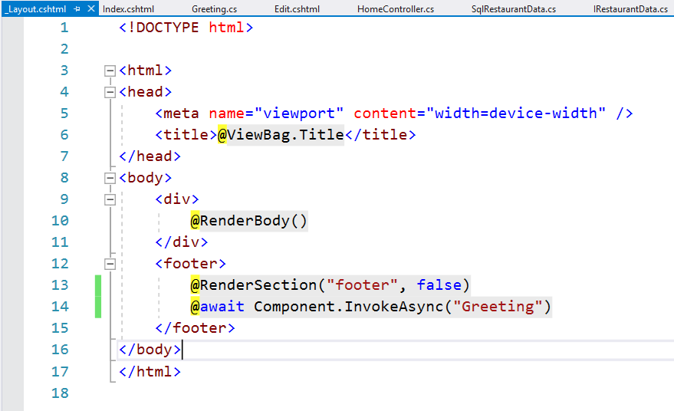
View Components
Notes:
View Components
We now want the configurable greeting to display on every page of the application at the bottom of the page, and, therefore, it's no longer the responsibility of the Index view to display this greeting.
We would probably go into the HomePageViewModel and remove the current greeting from that model and remove any reference to the IGreeter service and the current greeting from our HomeController.
We’re going to leave that as an exercise for you. All we’re going to do is remove the section that displays that current greeting in the footer.
We want to give all responsibility for displaying that greeting to the Layout view. The problem with the Layout view, though, is we really cannot use an @Model directive here.
We cannot rely on a controller action to build a model that the Layout view can consume.
It is possible, but it always creates difficulties in applications. Instead, we want the ability to use a view component, which is completely independent of whatever controller is currently executing and whatever model is being used to render the view because the Layout view will be used with different views that use all sorts of models.
This view component is responsible for getting the greeting and rendering some HTML into our Layout view.
The way we invoke a view component is to use the component helper and tell it to invoke and then the name of the view component.
We’re going to create a view component called Greeting.
Ultimately this view component will render a partial view, and the output of the partial view will appear here where you see Component.InvokeAsync.
A view component is more than just a partial view. A view component is almost a complete MVC abstraction.
There is a class with a method that will get invoked. The method needs to build a model and pick which view to render.
It's just that that view is going to be a partial view that appears to render part of the page.
If you have used previous versions of MVC, you might have used the Html.Action helper to execute a child action.
In this version of the MVC framework, child actions are gone, and we use view components instead.
It's a much better solution to this problem of we want an independent component that can render a partial view with its own model into our page.
To create this view component, we create a new folder. In addition to the controller's folder, we’re also going to have ViewComponents.
Inside of ViewComponents, we add a class because, a view component is really all the MVC pieces put together.
You can almost think of the view component as a controller. We just never route to it.
We create a view component called Greeting, so this will be the Greeting.cs class.
A view component can inherit from a view component base class. This is in the Microsoft.AspNet.Mvc namespace.
We will bring that namespace in, remove the namespaces that we don't use, and just like a controller, a view component can have dependencies injected in.
If we want to get today's current greeting, we need to ask for an instance of the object that implements IGreeter that's in the OdeToFood.Services namespace.
We'll call this greeter. Just like we do with the HomeController, we will save the greeter off into a private variable.
The primary method that you implement for a view component is a method called Invoke.
This isn't a controller. This isn't something that we route to. It's not going to have multiple methods that get reached by different URLs.
It is a view component, and there's one method that gets invoked when we use @component.invoke in some other view. It's a method called Invoke.
This is going to return something that implements the IViewComponentResult.
You’ll notice a lot of parallels between controllers and view components.
In controllers we have IActionResult. It's the result of an action.
With a View Component it is a IViewComponentResult called Invoke.
Our model object is really just asking greeter for the current greeting.
Just like in a controller action, we can return a view.
One word of warning about the View helper method, and this is true both for view components as well as controllers, if your model is a simple string and you pass this string as the first parameter to the View method, the MVC framework sees that as the name of the view that you want to render. It doesn't see it as the model object. If you want a string to be your model object, we have to explicitly specify our view name and then pass in the model object.
We want to render a view called Default passing in the string as our model, and the name Default would be the default for a view component.
We just need to create that view.
The location for view component views, it follows a convention much like the convention we already have where all of the views related to a specific controller, like the HomeController, appear in a folder, and shared views appear in the Shared folder.
View component views will always appear in a Components folder, and we place this Components folder in the Shared folder.
That means this is a view that is rendered by a view component that can be used from anywhere in the application.
We could also place a Components folder into the Home folder for views that will be rendered from view components that the HomeController uses.
Inside of there, we need a folder for each view component. Since our view component is named Greeting, we will also call this folder Greeting.
We explicitly said that we wanted to render a default view, or the name of the view is Default, so we create a new MVC View Page that is called Default.
This can be a very simple view. All we need to do is declare our model. It's of type String.
And inside of a section, we render in small print the model value.
We save all our files, come back to the browser and refresh.
We have our message in slightly smaller print, but that message should now appear on every page of the application because it's rendered from a view component using Component.Invoke from our Layout page.
A view component is a very robust abstraction.
We could inject IRestaurantData into the view component, and it could retrieve restaurant information if it needed to. It gets to build its own model and render its own partial view.

Slide 20
Razor syntax reference
We only covered a part of the Razor markup syntax
Study the documentation on https://docs.microsoft.com/en-us/aspnet/core/mvc/views/razor and make sure you know about
Escaping the @ symbol. E.g. <p>lector@@pxl.be</p>
Implicit Razor expressions. E.g. <p>@DateTime.Now</p>)
Explicit Razor expressions. E.g. @(DateTime.Now - TimeSpan.FromDays(7))
Razor code blocks and transitions

